Slide 1
37.1
Smart reservoir within e-advertisement app

Slide 2

Vsevolod Pus`
Volodymyr Popovych
Stanislav Melnik
Bogdan Nazar
Roman Veseliak
Ivan Sapiga
Mentor
Mykhailo Struchynskyi
Team

Slide 3


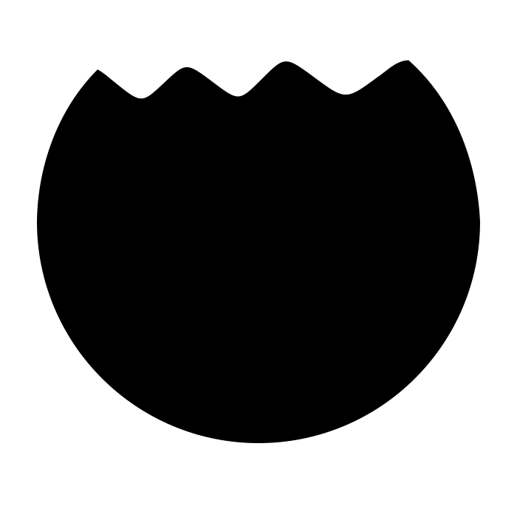
Project Overview
Our service is created to control water level in your bottle within android app

Slide 4
Data Flow

Slide 5
Data Flow

Slide 6
How does it work?
We`ve got conductivity sensors made of 4 wires(1 for earthing and 3 for levels) attached to the wooden bar and placed inside the reservoir. To activate sensors at least one of level wires must be in water with the earthing wire and then NodeMCU changes its status depending on the number of level wires.

Slide 7
Features
Refresh level in adroid app
Level change prediction
Encrypted communication channel
Future features
Binding user and bottle id via QR code
Increase test coverage

Slide 8




Idea
Posibility to refresh current level in android app
Technologies

Slide 9


Idea
To predict level change using previous data stored in Data Base
Technologies

Slide 10
Idea
Encrypt communication channel
Technologies

Slide 11
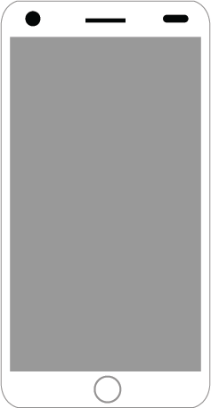
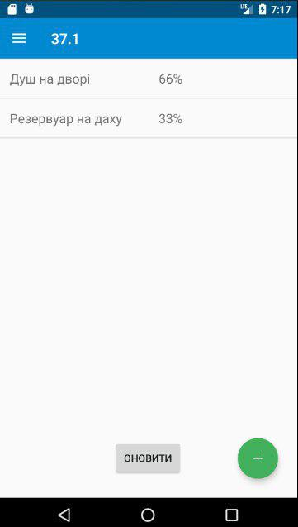
Water level in app

Slide 12

Tests
For greater productivity,as well as avoiding errors, have been written tests

Slide 13
To create our project was used NodeMCU microcontroller, so custom firmware war written for this system
NodeMCU

Slide 14
Message Broker(RabbitMQ)
We used Rabbit MQ to:
Manage a workload que
Providing reliable storage
Guaranteed message delivery

Slide 15
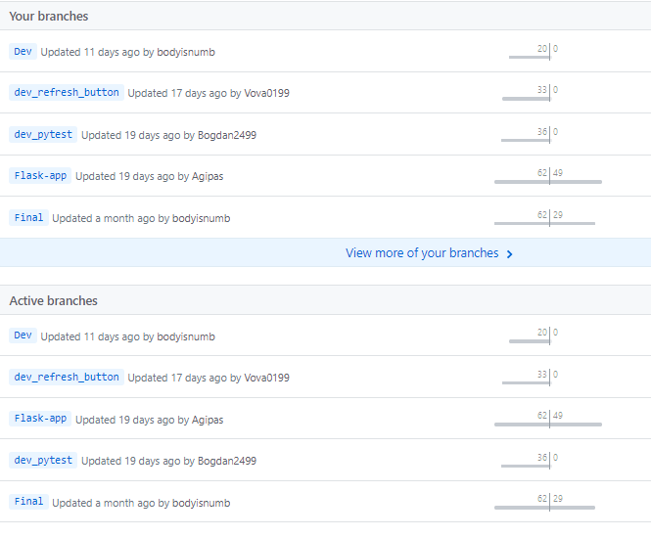
GitHub

Slide 16
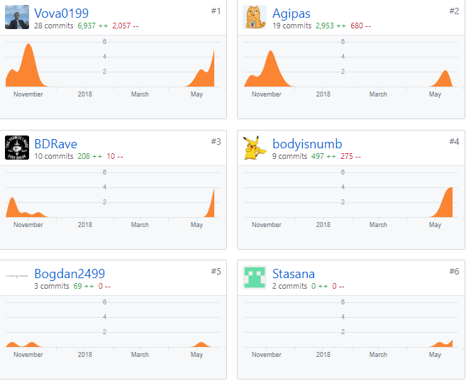
Team progress

Slide 17
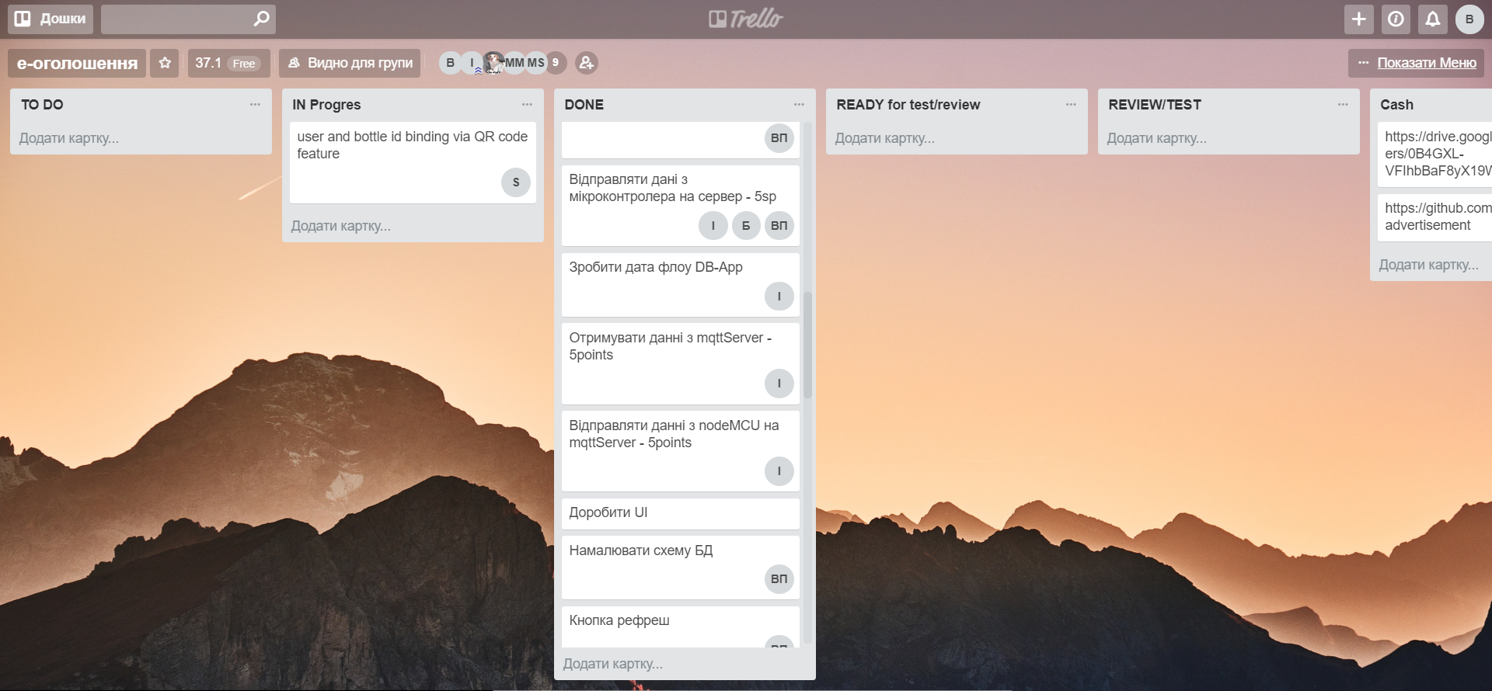
Trello

Slide 18




Technologies
MySQL
Java Android
Retrofit 2
Flask
PyTest
RabbitMQ
Python
ArduinoIDE

Slide 19
Demo

Slide 20
Thanks for attention
Any question?

